Slide 1
Opening Remarks
2024 DOELAP Radiobioassay Assessor Training Idaho Falls, ID
David L. Pugh, CHP, RRPT
Office of Worker Safety and Health Policy (EHSS-11) Office of Environment, Health, Safety and Security
U.S. Department of Energy

Slide 2
DOELAP Administrator – About me
Air Force active duty (1997-2017)
Air Force Dosimetry (2017-2021), Technical Director
NVLAP accredited for passive and active dosimetry
Transitioned from Panasonic to Landauer OSL in 2020 (in-house program)
Radiation Services Lab (2021-2023), Lab Manager & Supervisor
Dosimetry
Radioanalytical
Joined EHSS-11 team in April 2023
10 CFR 835
DOELAP

Slide 3
Office of Worker Safety and Health Policy
What we do -
Rulemaking: 10 CFR 707, 835, 850, 851
Worker Safety and Health Policy Clarifications

Slide 4
Office of Worker Safety and Health Policy

Slide 5
Join the EHSS-11 mailing list by scanning the QR Code
WebEx invitations
Policy Clarifications
Standard/Directive Developments
Rulemaking news
Worker Safety and Health Event Notifications

Slide 6
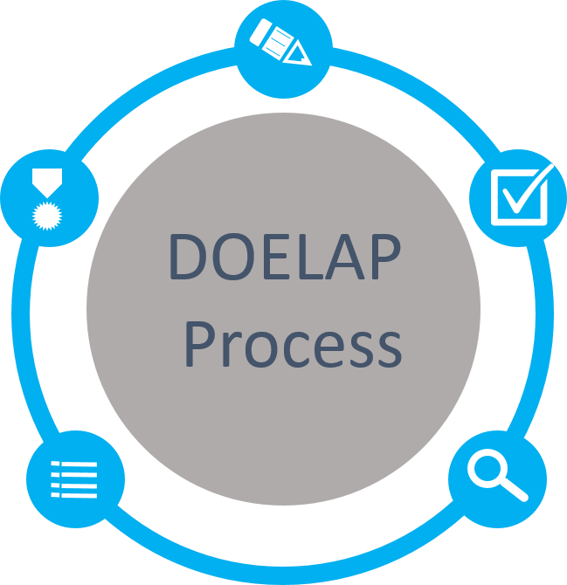
DOE Laboratory Accreditation Program (DOELAP)
Application
Quality Assurance Program
Field Office Review
Performance Testing
ANSI N13.11, Personnel Dosimetry Performance Criteria and Testing
ANSI N13.32, Performance Testing for Extremity Dosimeters
ANSI N13.30, Performance Criteria for Radiobioassay
Accreditation
Period of 3 years
Notify DOELAP of changes
Oversight Board Review
Complete Package
Recommendations to Administrator
On-Site Assessment
Direct observation and evaluation
Conducted by technical experts
Notes:
The DOELAP circle of life

Slide 7
DOELAP Administration
Success in DOELAP is a team effort:
Radiological and Environmental Sciences Lab
Office of Worker Safety and Health Policy
Oversight Board
DOELAP Assessors
DOE Site Office Managers
Personnel dosimetry and radiobioassay programs across the complex.
Notes:
DOELAP established in 1986 to ensure monitoring across the complex is:
Consistent,
Accurate, and
Conforms to accepted standards.
DOELAP’s continued success as the gold standard for accreditation is a team effort:
Office of Environment, Health, Safety, and Security,
Radiological and Environmental Sciences Laboratory,
Oversight Board,
Assessors,
DOE Site Office Managers,
Dosimetry Programs across the complex.

Slide 8
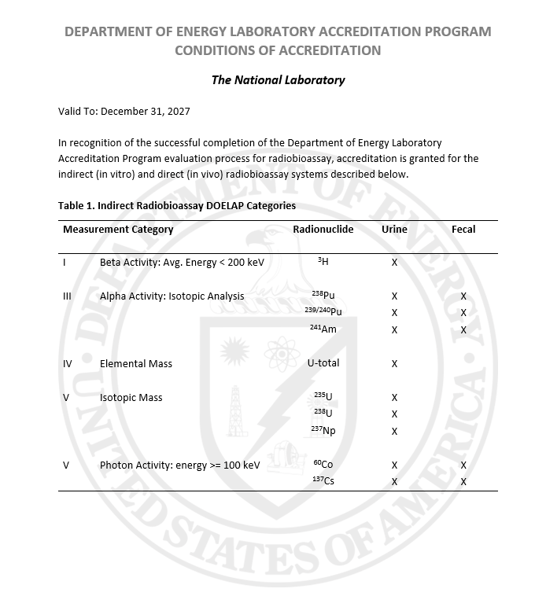
DOELAP Administrator – my tasks
Meet and work with STM weekly
Draft and issue Accreditation Certificates and Conditions of Accreditation
Approve technical equivalencies
Process amendments
Process appeals
Appoints and removes Oversight Board members
Process DOELAP Exceptions to accreditation
Meet with Program Offices and Field Element representatives, as needed
Maintain DOELAP Standards

Slide 9
Understanding RevCom
RevCom is the system for reviewing and approving draft standards
Technical Standards review in RevCom consists of four phases:
Project Justification (15 business days) – Author submits Project Justification Statement for reviewer to consider whether a project should go forward
Review and Comment (90 days) – Technical Standards Managers assign SMEs to review a draft and submit comments (60 days)
Author responds to comments (30 days)

Slide 10
Understanding RevCom
3. Response Negotiation (30 days) – Reviewers have an opportunity to review the author’s response to comments and redline showing changes to the draft in response to comments
4. Concurrence (10 business days) – Technical Standards Managers and SMEs who reviewed the original draft concur or non-concur with the revised draft

Slide 11
DOELAP Oversight Board
Current Membership
Govind Rao, Chair, ORNL (Re-appointment 2024)
Michael Souleyrette, Y-12 (Re-appointment 2024)
Milan Gadd, LANL (Re-appointment 2024)
Kelly Crandall, SRS (Re-appointment 2024)
Cheryl Antonio, HMIS (2020)
Nathan Elliot, SNL (2022)
Ken Veinot, Y-12 (2023)
Richard Pierson, PNNL (2023)
Adam Stavola, TJNAF (2023)

Slide 12
Professional Conduct
Professionalism, dedication, and ethical principles must be placed above private gain.
Must abstain from financial, employment, private or any other interests that conflict from conscientious performance of duty.
Ensure non-public DOELAP information must not be disclosed or used to further any private interest.
Must not solicit or accept gifts from any activity whose interests may be substantially impacted
Must not make any unauthorized commitments of DOELAP
Must act impartially and not give preferential treatment
Avoid any actions creating the appearance of violation of ethical standards
1
2
3
4
5
6
7

